Slide 1
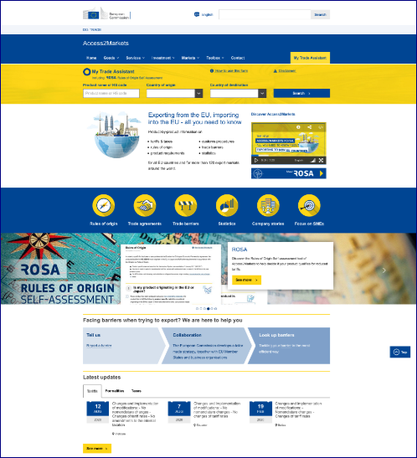
The online portal Access2Markets
Your gateway to EU trade information
Notes:
Good morning everyone,
Let me start this practical part of the conference by
Presenting a few points on where we see the added value of this portal and then I will give an overview on the data available to you and other content elements.

Slide 2
Objectives Why an Access2Marktes portal?
Support companies in their efforts to internationalise their business
Make it easier to assess export opportunities
Inform about trade agreements and support their implementation
Provide information for ALL productS, for each agreement and for 135 export markets
Break down the legal language into practical information
Serve information easy to access online, multilingual, on-the-go

Slide 3
User groups Who is this information for?
Companies, in particular SME within the EU and around the world
Business organisations and associations
Business Advisory Services, such as the Enterprise Europe Network
Trade Promotion Organisations

Slide 4
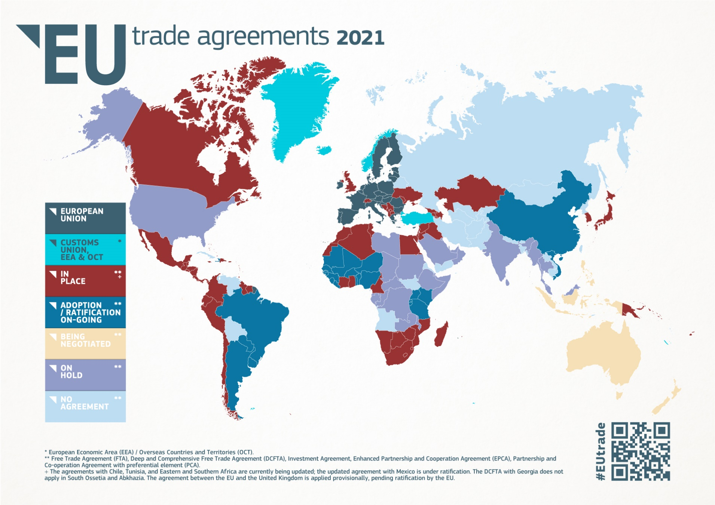
A2M informs on all EU trade agreements

Slide 5
A2M informs on 135 exports markets *
*) Only accessible if the user is personally located within one of the Member
States of the European Union, Turkey, North Macedonia, Albania, Montenegro,
or Serbia.
Notes:
Here on display are the export markets we are covering with our data on trade conditions.
With these 120 countries we cover ard 90% of European exports.
For these 120 countries we deliver product-specific information such as tariffs,
Customs formalities and product rules

Slide 6
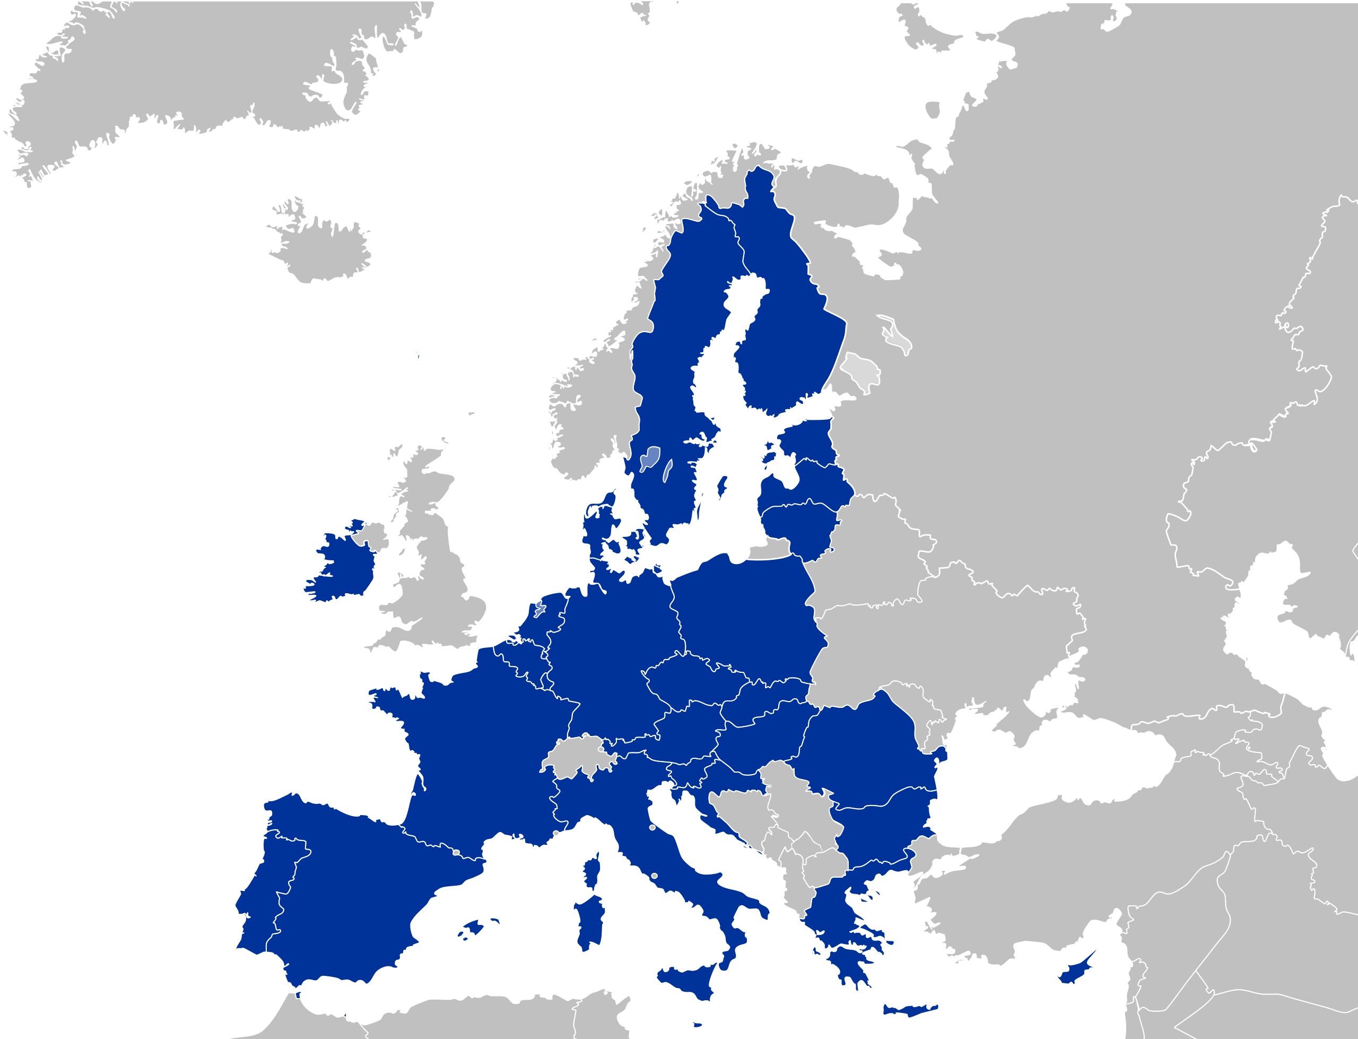
A2M informs on the EU market
Notes:
Here on display are the export markets we are covering with our data on trade conditions.
With these 120 countries we cover ard 90% of European exports.
For these 120 countries we deliver product-specific information such as tariffs,
Customs formalities and product rules

Slide 7
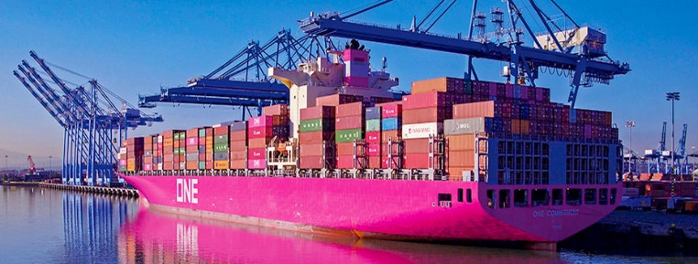
Which results can you expect from your search?
Tariffs
Internal taxes
Rules of origin
Customs procedures, product requirements o
Trade barriers
Trade statistics
Procurement information on Canada and Japan more countries will be added gradually
Services and Investment information for Canada and UK for legal and maritime service, more to come around spring 2023

Slide 8
What is the Single Entry Point ?
The Single Entry Point is a contact tool for ALL EU stakeholders facing potential trade barriers in third countries.
The SEP team ensures efficient follow-up of complaints received:
Assessment of the issue by experts of the European Commission
Explanation of the outcome and potential follow-up actions

Slide 9
How to use the Single Entry point
If you face a trade barrier, please first check registered trade barriers in third countries
If the issue is not already registered:
A complaint form is available directly on the “Contact” page of the Access2Markets website.
Possibility to file a pre-notification contact: the SEP team will help decide whether to launch the complaint & provide guidance for the complaint process.

Slide 10
Trade Assistant for Services and Investment
Scope
Two countries (national and subnational level)
Canada
United Kingdom
Two services sectors
Legal services
Maritime Transport services

Slide 11
Trade Assistant for Services and Investment
Content
Requirements EU companies need to fulfil when exporting services
Cross-border supply
Commercial presence
Movement of professionals
Sources of information
Links to laws and regulations
Regulatory authorities responsible

Slide 12
More information
Contact us:
https://trade.ec.europa.eu/access-to-markets/en/contact-form
Follow us on Twitter:
EU Trade
Leaflets and other information material

