Slide 1

Science and Technology Park
…research, development, innovation, entrepreneurship
ΚΥΠΡΙΑΚΗ ΔΗΜΟΚΡΑΤΙΑ / ΠΝΕΥΜΑΤΙΚΑ ΔΙΚΑΙΩΜΑΤΑ 2025

Slide 2
A catalyst for innovation and economic development
The Cyprus Science and Technology Park has a vision to…
…establish Cyprus as an internationally recognized tech hub for innovation and entrepreneurship, where research, technology and sustainability converge to create opportunities, accelerate progress and drive economic growth in a globally connected environment
The Park has a dynamic purpose to serve as a transformative platform for business creation, technological advancement and economic development, through:
1. Fostering collaboration between startups, well-established enterprises, research institutions and the academia, enabling cross-sectoral partnerships and fostering synergies.
2. Establishing of a dynamic and interconnected ecosystem, integrating research, industry and education, enabling knowledge transfer, scaling, co-creation and innovation.
3. Reinforcing Cyprus’ position as a regional hub for research and innovation and enabling knowledge-driven economic growth and investment attraction.

Slide 3

A Park guided by values and principles
Values
Guiding principles
A commitment to developing and applying advanced technologies and innovative solutions
The Park will cater to the needs of diverse stakeholders, including start-ups, SMEs, research institutions, and multinational corporations, uniting all the key players in the scientific and technological sectors
The Park will provide state-of-the-art infrastructure and resources tailored to the specific needs of innovation-focused enterprises, ensuring operational excellence and scalability
Innovation
Inclusivity
Effectiveness
Global Positioning
The Park will enhance Cyprus' standing as a leader in innovation by fostering international partnerships and showcasing success stories in science, technology and entrepreneurship
Collaboration
Sustainability
Establishing robust networks between businesses, academia, and government to unlock synergies
Ensuring environmentally responsible growth, social inclusivity, and long-term economic viability

Slide 4

A choice between areas of focus for the Park
The thematic focus and areas of expertise for the Park shape its identity, determine its competitive advantage, and ensure alignment with Cyprus’ national strengths and global trends.
Suggested Thematic Priorities:
Position Cyprus as a leading regional hub for solar energy innovation and export.
Advance research, international collaboration, and technology development
Create a high-impact innovation ecosystem for nanotechnology and advanced materials
Position Cyprus as a regional leader in advanced material science
Establish Cyprus as a centre of excellence in respiratory health research and care
Promote innovation in medical technologies
Develop a dedicated hub for gaming and software development
Attract talent, foster start-ups, and align with the national digital strategy
Energy and Energy Storage
Health and Medical Technologies
Nanotechnology and Advanced Materials
Digital Technologies and Informatics – Gaming and Software Development
Note: Prospective investors can select a thematic priority that aligns with their interests and local challenges. However, those who choose the recommended thematic priorities will receive additional points.
Notes:
Energy and Energy Storage:
Position Cyprus as a leading regional hub for solar energy innovation and export, leveraging its high solar exposure and supportive policy environment.
Advance research, international collaboration, and technology development in solar energy, energy storage, and smart grid integration to support national and EU energy targets
Health and Medical Technologies
Establish Cyprus as a centre of excellence in respiratory health research and care, capitalising on its climate, healthcare infrastructure, and medical tourism potential.
Promote innovation in medical technologies focused on diagnostics, treatment, and digital health solutions to address respiratory diseases and improve public health outcomes.
Nanotechnology and Advanced Materials
Create a high-impact innovation ecosystem for nanotechnology and advanced materials with applications across energy, healthcare, and defence sectors.
Foster interdisciplinary R&D, industry-academia collaboration, and international investment to position Cyprus as a regional leader in advanced material science.
Digital Technologies and Informatics – Gaming and Software Development
Develop a dedicated hub for gaming and software development that supports digital innovation across sectors including healthcare, education, and defence.
Strengthen Cyprus’s position in the global digital economy by attracting talent, fostering start-ups, and aligning with the national digital strategy.

Slide 5


Land use and initial development
The total land area designated for the Park amounts to 192,620 m², with an approximate:
30% of the total area of the Park to be allocated for internal road networks, ensuring efficient access and seamless connectivity within the Park, public open space, and community facilities.
Net usable area of 134,834m², to be dedicated to technological and scientific activities, such as research laboratories, office spaces, and innovation hubs.
The overall building density ratio may be increased to a maximum of 0.45:1 for the total net usable area of the Park, subject to sufficient justification. In such a case, the total allowable buildable area may not exceed 65,000 m².
Maximum Building Ratio | Maximum Plot Coverage Ratio | Maximum Numbers of Storeys | Maximum Height (m)
0.40:1 | 0.30:1 | 2 or 3 | 12

Slide 6
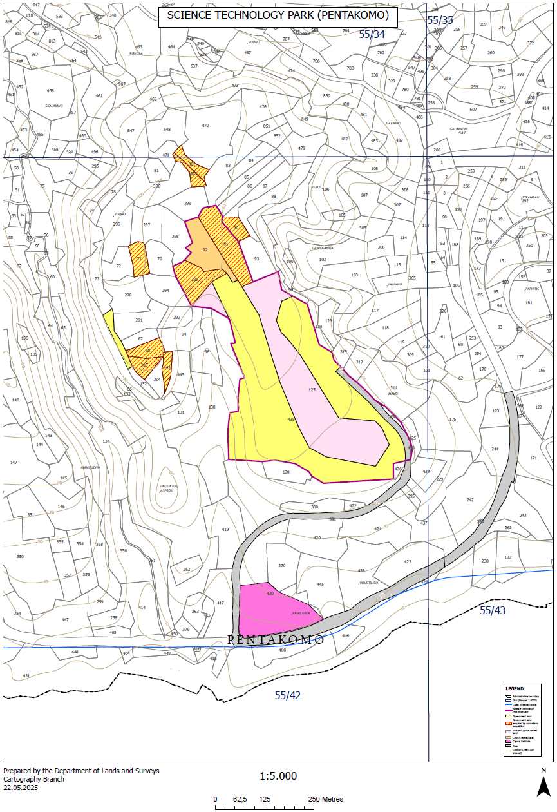
Land use and initial development – Cont.
Official Topographic and Administrative Map of the Science and Technology Park (Pentakomo) - Prepared by the Department of Lands and Surveys (Cartography Branch), this map outlines the designated boundary of the Science and Technology Park (STP) in Pentakomo

Slide 7

Facilities and Infrastructure: Operations and Services Area
The administrative and operational hub of the Park will house key facilities, acting as a reference centre for the Park’s spatial organisation, ensuring seamless coordination of activities and services.
The following developments and uses will be permitted within the Core Operations and Services Areas:
Administration Building
Conference and Exhibition Centre
Offices for Enterprises and Organisations
Commercial/ Retail Premises
Business Centre
Business Incubators
Small-Scale Recreational and Well-being Facilities
Notes:
Administration Building: Hosting security and maintenance services, as well as visitor information and guidance points
Business Centre: Offering office spaces and business support services to resident companies and visitors
Conference and Exhibition Centre: Providing a venue for industry events, networking, and showcasing technological advancements
Business Incubators: Dedicated office spaces with integrated services, including administrative support and shared office equipment, to foster start-ups and research-driven enterprises
Offices for Enterprises and Organisations: Accommodating businesses and institutions whose activities align with the permitted uses in the Technological Business Units area
Commercial/ Retail Premises: Serving the daily needs of employees and visitors without compromising the Park’s primary focus on innovation and technology
Small-Scale Recreational and Well-being Facilities: Including accommodation/guest facilities, restaurants, cafeterias, gyms, and sports facilities (e.g., tennis courts) to support the well-being and productivity of the Park’s users

Slide 8
Facilities and Infrastructure: Business Units area
The Technological Business Units zone will provide dedicated spaces for enterprises engaged in cutting-edge technological development and innovation to establish their operations
The following developments and uses will be permitted within the Business Units Area:
The Technological Business Units area will support the production and development of low-impact, high-technology products and services, including:
Additionally, complementary facilities will be permitted in this area to enhance research and innovation activities, such as:
Telecommunications and Microelectronics
Smart Systems of Automatic Control
Information and Communication Technologies (ICT)
Biomedical Engineering and Robotics
Energy and Environmental Technologies
Advanced Networks and Technological Developments
Maintenance of Information Technology Software
Research Centres
Education Buildings and University Units
Professional Laboratories
Data Management Centres
Facilities and production lines for the development and production of innovative products and services, in line with the EU’s Strategic Technologies for Europe Platform regulation in the following areas: Digital and Deep Technology Innovation, Clean and resource efficient technologies, Biotechnologies

Slide 9

The Investor and Government share responsibilities
Role of the Government
Role of the Strategic Investor
Facilitating the Investment Process: Identifying and securing a suitable Strategic Investor.
Allocating the Necessary Land: Providing the designated area for the Park’s development.
Regulatory Support: Ensuring the development aligns with Cyprus’s legal and economic priorities while expediting the acquisition of necessary permits and approvals for the establishment and operation of the Park.
Construction of public road and provision of services: Ensuring the connectivity of the Park with the main highway, and installment of electricity, telecommunications and water supply infrastructure, within 18 months.
Rent-Free Period: Five-year rent-free period from the signing of the Land Lease Agreement to the Successful Tenderer.
Overseeing Development and Operations: Managing the Park’s growth, infrastructure development, and service provision to ensure its long-term success.
Defining Goals and Thematic Priorities: Establishing a dynamic framework that aligns with Cyprus’s innovation and economic development objectives.
Ensuring Financial Viability: Implementing a sustainable business model to attract and support high-tech companies, research institutions, and start-ups.
Managing Stakeholder Engagement: Coordinating with industry, academia, and investors to foster collaboration and innovation.

Slide 10

Three-phase procurement process for the investor selection
Phase C: Approval and Implementation
Phase B: Detailed Proposal Submission and Final Selection
Phase A: Preliminary Evaluation and Shortlisting
The tender document specifications were published on 19/06/2025, with a three-month submission period ending on 12/09/2025
The selected tenderer finalises all studies and reports (architectural, infrastructure, financial, and environmental) in order to obtain all necessary approvals, ensuring that the project is fully compliant and ready for execution.
Shortlisted candidates submit comprehensive master plans, financial models, governance structures, and risk management strategies. A thorough evaluation determines the highest-scoring tenderer, who is then awarded the contract.
Focuses on assessing the strategic vision, conceptual master plan, and the capabilities of potential investors, ensuring alignment with the Park’s objectives. This phase results in the shortlisting of the most qualified tenderers for the next stage.
October 2025
December 2025
April 2026
May 2026
July 2026
10

Slide 11







Provisional Timeline of Actions
October 2025
June 2025
Publication of Tender Documents
Launch of the competitive procedure accounting for the Easter period.
Proposal Submission Deadline
Six-month period for submission of proposals.
Evaluation of Proposals
Assessment and Shortlist of preferred candidates prepared.
April 2026
July 2026
Final Proposal Submission
Submission of final master plan, economic studies (including ROI), and risk management strategy.
November December 2025
May 2026
Final Proposal Submission
Selection of the highest-scoring candidate and project award..
July 2026 onwards
Lease Agreement Signing
Conclusion of lease agreement with selected contractor.
Implementation Phase
Final design, permitting, and phased project execution. Core infrastructure to be completed by 31 July 2031.

Slide 12

Cyprus provides incentives for the investor
Financial Incentives
Tax Incentives
Planning and Building Incentives
Infrastructure Support: To ensure the Park is investment-ready, the Government may provide funding and deliver essential infrastructure such as transport and utility networks.
Investment Aid: May be provided to the strategic investor for the development of essential infrastructure.
Long-term Land Lease Agreement: With initial duration of 33 years, and renewal option for two additional terms.
IP Tax Regime: 80% of the qualifying profits from IP rights are exempt from taxation.
Tax Exemptions for Employees: 50% income tax exemption is available for employees earning over €55,000- and 20%-income tax exemption for employees earning less than €55,000.
Increased Building Ratios: The building ratio for the Park may increase up to 0.45:1, with a maximum buildable area capped at 65,000m².
Height Adjustments: The Planning Authority may allow certain buildings to exceed the maximum number of floors and height limits to accommodate strategic needs, provide architectural harmony and larger open spaces on the ground floor.

Slide 13

Cyprus provides incentives for the investor
Renewable Energy Integration within the Park
Refined Visa and Work Permit Incentives
Operational Support
Exclusive Renewable Energy Power (REP) System: The investor may install a rooftop REP system of up to 5 MW capacity for exclusive on-site consumption.
Access to Government Programmes: Cyprus’ Renewable Energy Subsidy Schemes support the installation of energy-efficient and renewable energy systems.
Green Energy Certification: Facilities within the Park that adopt renewable energy systems may apply for green building certifications.
Cyprus Start-up Visa Scheme: For non-EU entrepreneurs of innovative, high-growth potential startups.
Work Permits for Non-Nationals: Expedited work permit processing for high-skilled employees.
Golden Knowledge Programme: fast-track citizenship for high skilled personnel (e.g., research& innovation).
Permanent Residency Programmes: Fast Track Residency.
Simplified Employment of Third-Country Nationals: For high-demand roles in sectors like nanotechnology.
Temporary Work Visas for Researchers and Academics: For short-term projects.
Bureaucracy-Free Operations: The Government will ensure all necessary permits for starting the Park's construction are obtained promptly, minimizing administrative burdens.
Tenant Base Security: The Government will secure public organisations and centres of excellence as initial tenants, providing financial stability and enhancing the Park’s reputation as a premier innovation hub.

Slide 14

Thank you
ΓΡΑΦΕΙΟ ΚΥΒΕΡΝΗΤΙΚΟΥ ΕΚΠΡΟΣΩΠΟΥ
ΚΥΠΡΙΑΚΗ ΔΗΜΟΚΡΑΤΙΑ / ΠΝΕΥΜΑΤΙΚΑ ΔΙΚΑΙΩΜΑΤΑ 2020

